Slide 1
Nazi Germany
Keeping Control:
The Terror State – How did the Nazi Regime achieve this ?

Slide 2
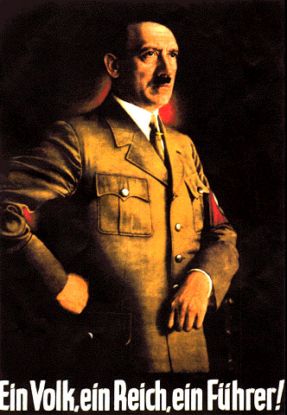
Key Quote on use of TERROR
“Terror is the best political weapon for nothing drives people harder than a fear of sudden death.” Hitler

Slide 3
How did Hitler keep control of Germany?
The Terror State
Propaganda
Secret police called the Gestapo would spy on and arrest enemies of the state.
Mass Rallies, Posters and Propaganda films.
Keeping Control of Germany
The Nazis controlled and censored the radio & newspapers.
SS were responsible for running the concentration camps.
School children were indoctrinated with Nazi ideas at school.
Everyone was scared of being arrested by the Gestapo and being put in a concentration camp.
Popularity
Ripping up the Treaty of Versailles.
Hitler Youth & the Young Maidens.
Creating Jobs

Slide 4
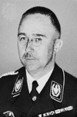
The Terror State
Both the Gestapo and the SS were run by Heinrich Himmler.
The Gestapo employed an army of spies who would inform on people of all ages and sexes.
However there were not as many Gestapo forces to survey all walks of life as some people think : they depended on informants to help them in their campaign of terror.

Slide 5
Enemies of the State: The list are all encompassing – Would you have been an enemy of the state ?
Communists.
Social Democrats.
Jews.
Trade Unionists.
Work Shy/Vagrants.
Homosexuals.
Mentally or Physically handicapped people.
Gypsies.
Germans who bought from Jews or helped them.
Pacifists.
Radical Christian Organisation.
Confessing Church members.
Basically anyone showing disagreement with the Nazi State.

Slide 6
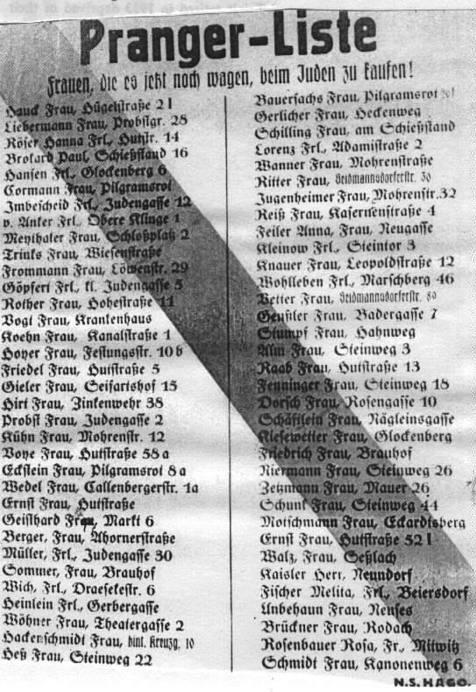
Enemies of the State: Evidence
This is a list of German women who were still purchasing goods from Jewish shops – you can decide what the impact would have been in publishing this list.
It was printed to scare or terrorise other people into not buying from the Jews. This was paramount to achieving the idea of limited opposition to the state.

Slide 7
How did the Terror State Work? FEAR
You are imprisoned for up to six months doing hard physical labour.
When you are released you tell everybody what has happened to you
Gestapo Spies inform on you
Fear
You are woken up by the Gestapo at 1 am in the morning and told that you have 5 minutes to pack your bags.
You are handed over to the SS who run the concentration camps.
By signing this form you are giving your consent to be put into a concentration camp.
Days or maybe weeks later you are interviewed and asked to sign form D11
You are arrested and thrown into a cell at the police station

Slide 8
How else did the Nazi Regime terrorise people ?
Everyone knew someone who knew someone else who had been in a concentration camp and did not want to go there themselves.
Favourite joke amongst Germans at this time: A man goes to the Dentist. The Dentist says: ‘Open Wide.’ The man sits up and says: ‘Not in front of a stranger.’ This was based on the idea that one could not trust a stranger and hence had to be careful to whom you told what.
800,000 Germans were imprisoned from 1933 – 1945 as ‘Enemies of the State.’ and many for being “asocial”
Notes:
There is a great BBC Video on this topic

Slide 9
Reverend Martin Niemoller, 1945 says of Germany at this time …an important lesson for us all to consider in voicing our opinions………..
When the Nazis came for the Communists
I was silent, I was not a Communist.
When the Nazis came for the Social Democrats
I was silent, I was not a Social Democrat.
When the Nazis came for the Jews
I was silent, I was not a Jew.
When the Nazis came for me
There was nobody left to protest.

Slide 10
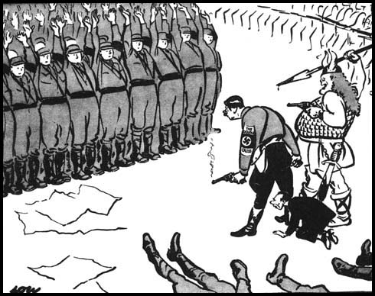
Checking your understanding
Cartoon by David Lowe, British cartoonist. 1934
How useful is this source to a Historian studying the nazi parties methods of control?
Time allowed: 20 minutes (including planning time)

